Slide 1
Creating Attractive Web Pages

Slide 2
Objectives
In this session, you will learn to:
  Apply styles to selective elements

Slide 3





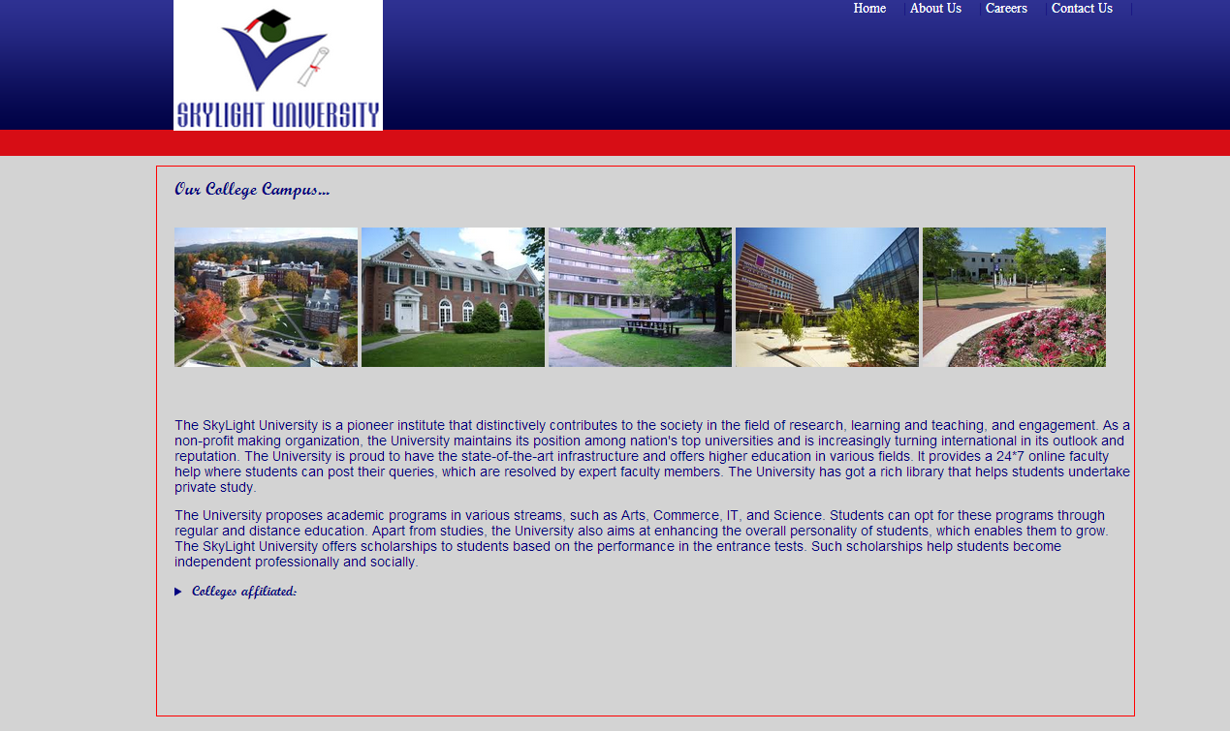
Applying Styles to Selective Elements
Scenario:

Slide 4
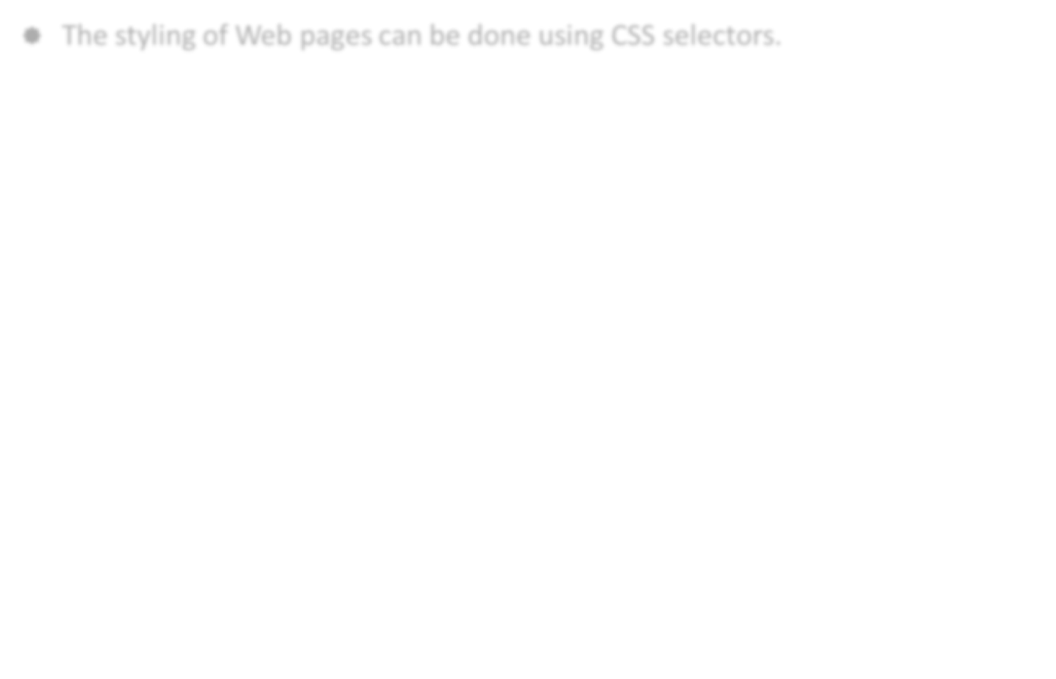
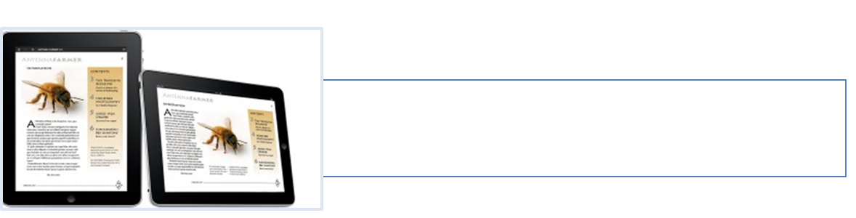

Applying Styles to Selective Elements (Contd.)
The styling of Web pages can be done using CSS selectors.
Use the animation, RWD_02_Enhancing_a_Web_Page_Using_CSS, to
understand the concept of applying styles to elements.

Slide 5
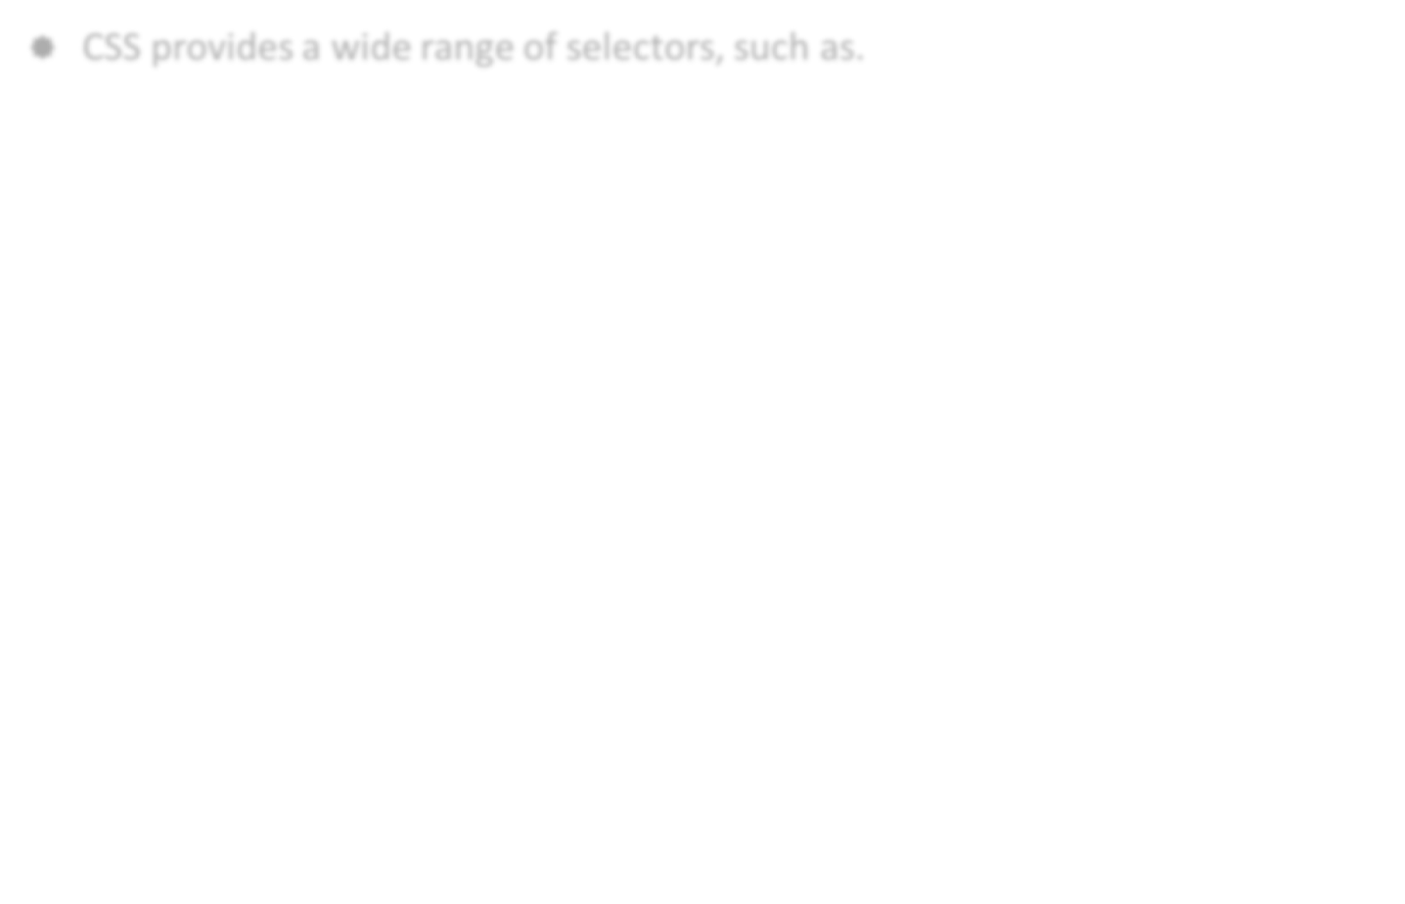
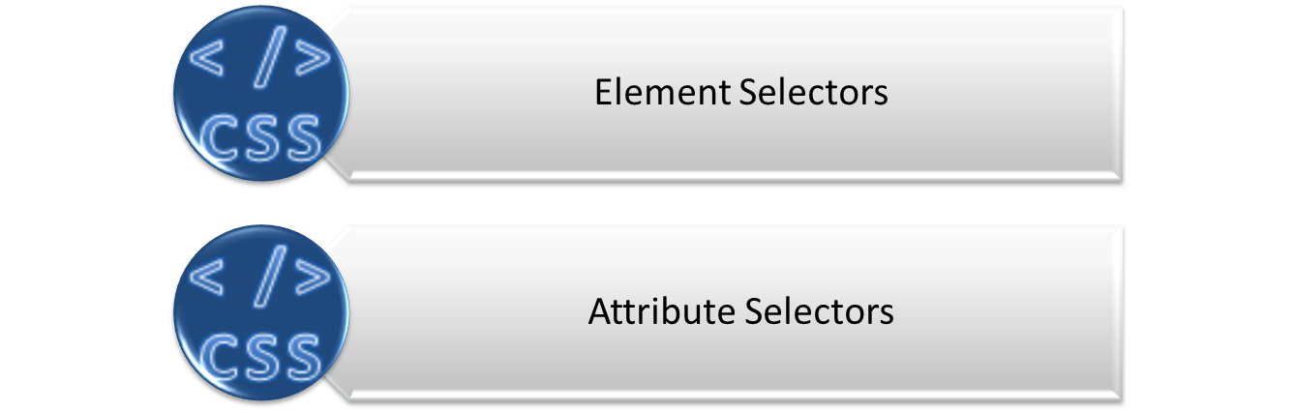
Applying Styles to Selective Elements (Contd.)
CSS provides a wide range of selectors, such as.

Slide 6
Element Selectors
Element selectors are the selectors that specify the selection criteria based on the names of the elements.
Some of the element selectors are:
  element1~element2
  :first-of-type
  :last-of-type
  :nth-child(n)
  :nth-last-child(n)
  :only-of-type
  nth-of-type(n)

Slide 7
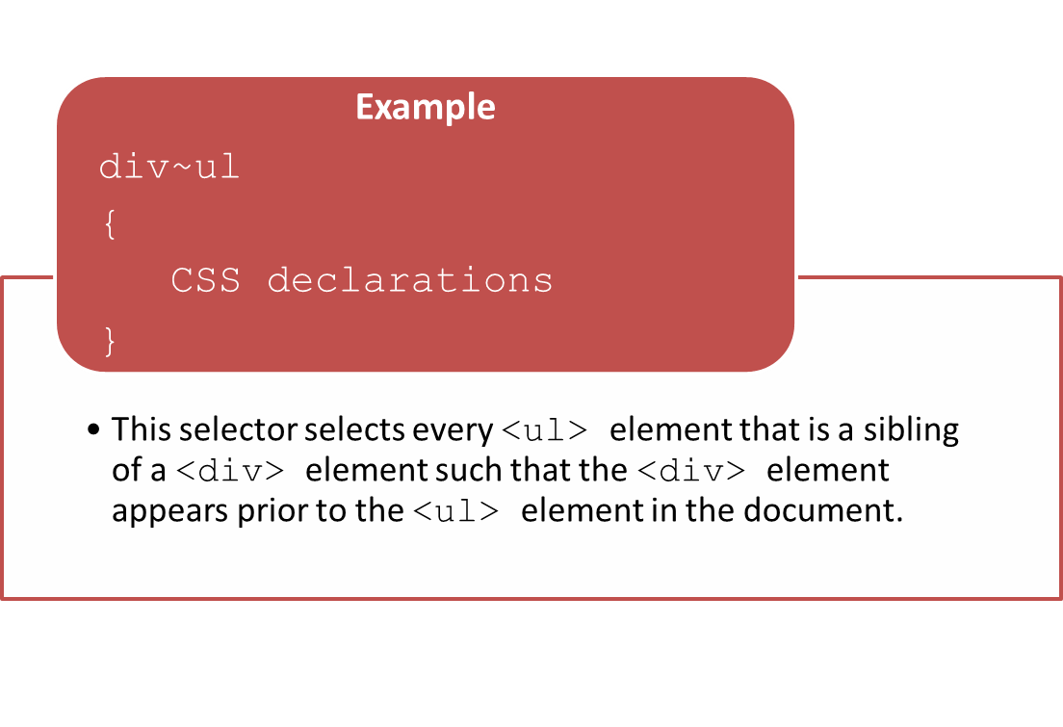
Element Selectors (Contd.)
The element1~element2 selector

Slide 8
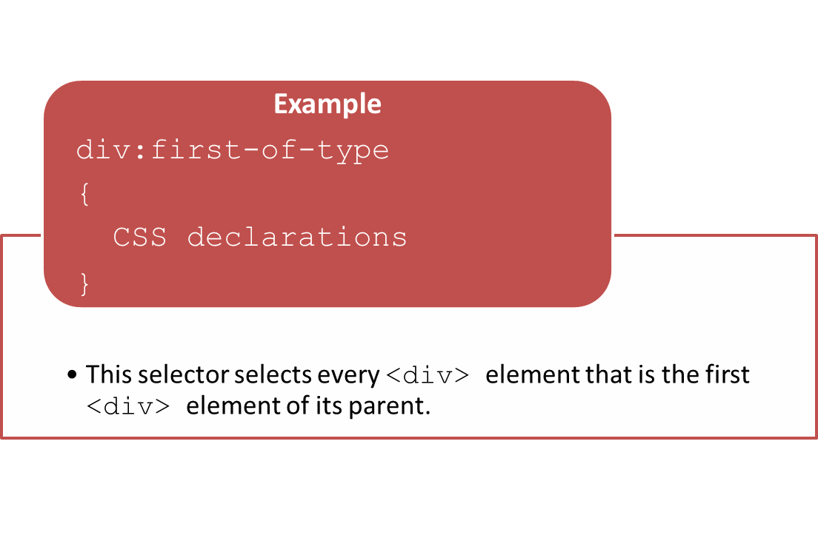
Element Selectors (Contd.)
The :first-of-type selector

Slide 9

Element Selectors (Contd.)
The :last-of-type selector

Slide 10
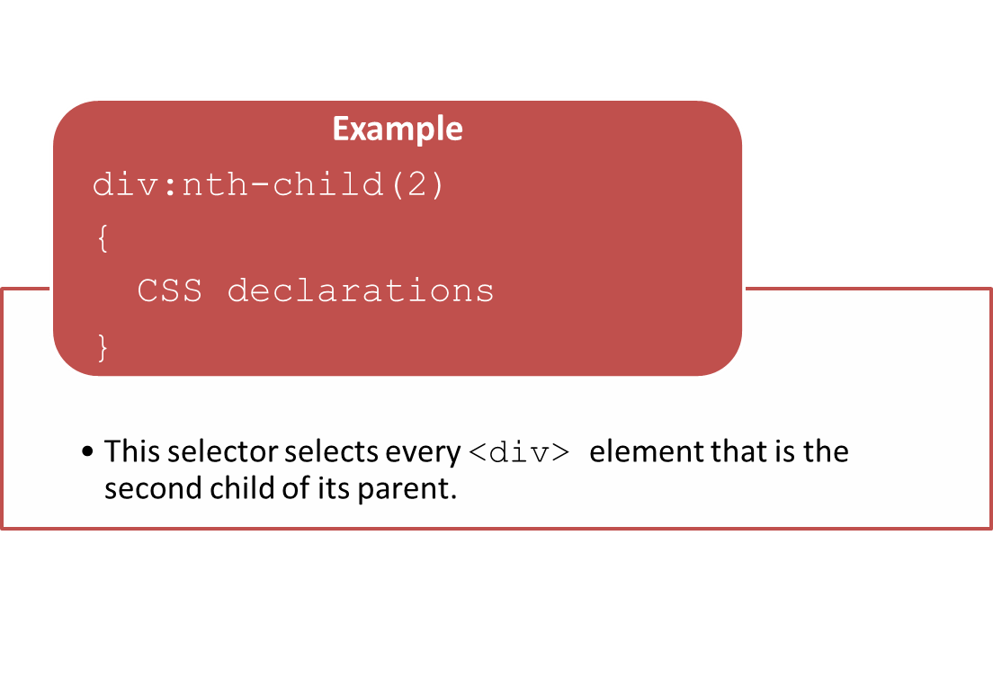
Element Selectors (Contd.)
The :nth-child(n) selector

Slide 11

Element Selectors (Contd.)
The :nth-last-child(n) selector

Slide 12

Element Selectors (Contd.)
The :only-of-type selector

Slide 13
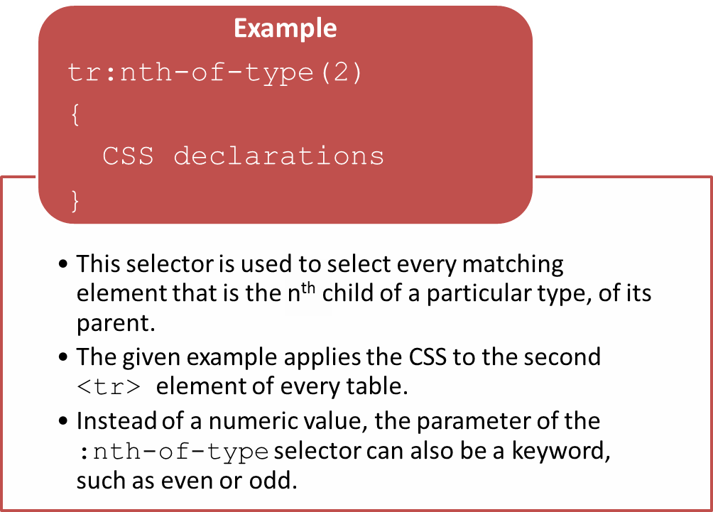
Element Selectors (Contd.)
The nth-of-type(n) selector

Slide 14
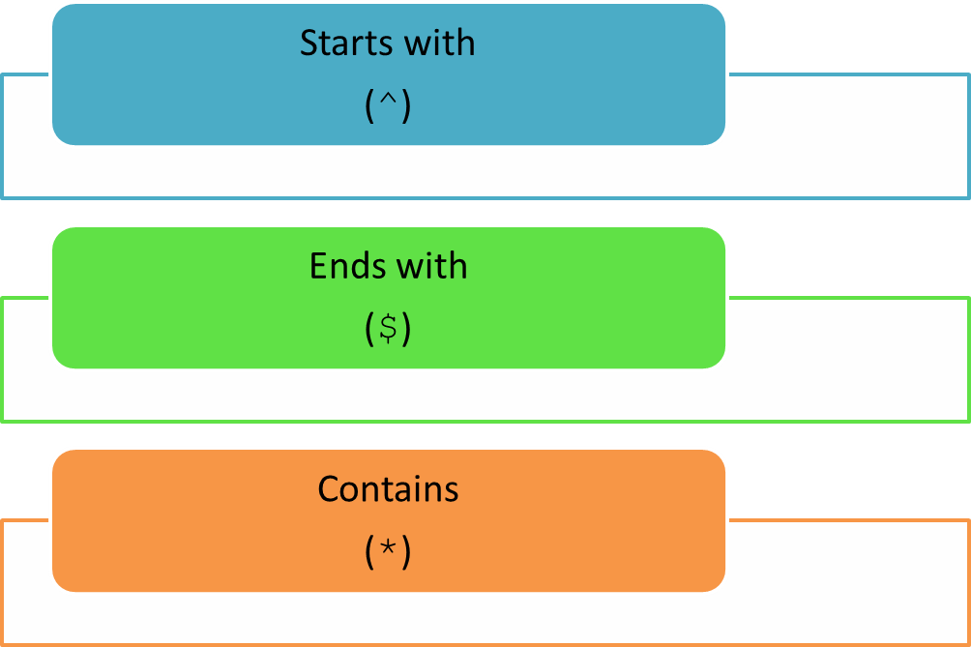
Attribute Selectors
Selectors that specify the selection criteria based on the attributes of elements are called attribute selectors.
CSS provides the following range of attribute selectors.

Slide 15

Attribute Selectors (Contd.)
The starts with (^) selector is used to select HTML elements that have the specified attribute with a value starting with the given string.
The syntax to use the starts with selector is.
attribute ^= value
{
css declarations;
}

Slide 16
Attribute Selectors (Contd.)
The ends with ($) selector is used to select HTML elements that have the specified attribute with a value ending with the given string.
The syntax to use the ends with selector is.
attribute $= value
{
css declarations;
}

Slide 17
Attribute Selectors (Contd.)
The contains (*) selector is used to select HTML elements whose specified attribute’s value contains the given string.
The string can appear at the beginning, end, or in the middle of the attribute’s value.
The syntax to use the contains selector is.
attribute *= value
{
css declarations;
}

Slide 18
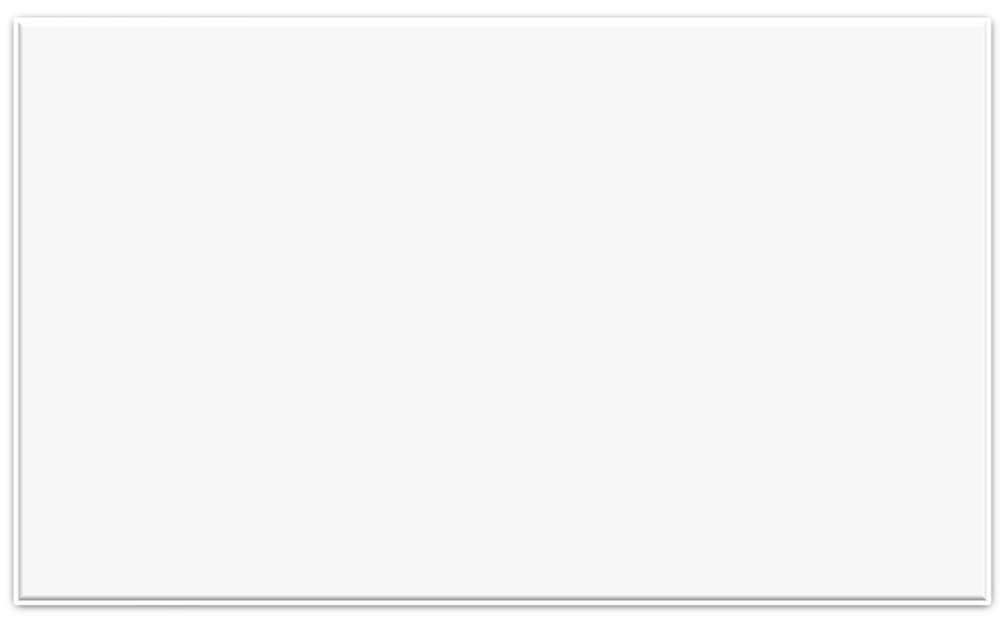
Attribute Selectors (Contd.)
To understand all the selectors, consider the following code snippet that displays the courses available at SKYLIGHT UNIVERSITY in a tabular format:
<Table border="0">
<TR>
<th colspan="7" class="Heading"><center><i><B>Course Details</B></i></center></th>
</TR>
<TR>
      <TH><B>Course Title</B></TH>
      <TH><B>Course Duration</B></TH>
      <TH><B>Eligibility Criteria</B></TH>
      <TH><B>Total Seats Available</B></TH>
      <TH><B>Fees</B></TH>
      <TH><B>College</B></TH>
      <TH><B>Enroll Yourself</B></TH>
</TR>
<TR class="SCHOLARSHIP PLACEMENT">
        <TD>AREA STUDIES</TD>
        <TD>Two Years</TD>
        <TD>Graduate</TD>
        <TD>25</TD>
        <TD>$200</TD>
        <TD>College of Cal Poly Pomona</TD>
        <TD><A href="">Register</A></TD>
    </TR>

Slide 19
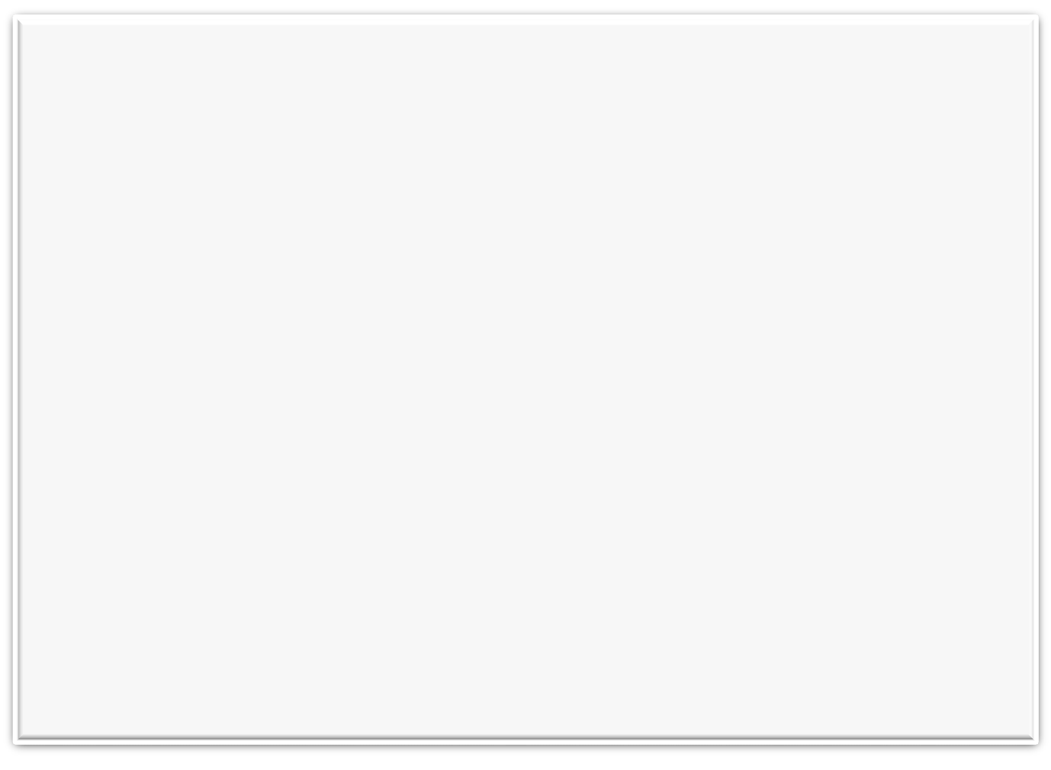
Attribute Selectors (Contd.)
      <TR class="PLACEMENT">
        <TD>BIOLOGICAL TECHNOLOGY</TD>
        <TD>Three Years</TD>
        <TD>Graduate</TD>
        <TD>10</TD>
        <TD>$1200</TD>
        <TD>Community College of Vermont</TD>
        <TD><A href="">Register</A></TD>
</TR>
      <TR class="SCHOLARSHIP HOSTEL">
        <TD>BOTANY</TD>
        <TD>Two Years</TD>
        <TD>Graduate</TD>
        <TD>5</TD>
        <TD>$1000</TD>
        <TD>College of Saint Elizabeth</TD>
        <TD><A href="">Register</A></TD>
</TR>
      <TR class="SCHOLARSHIP">
        <TD>CELL BIOLOGY</TD>
        <TD>Two Years</TD>
        <TD>Graduate</TD>
        <TD>30</TD>
        <TD>$400</TD>
        <TD>College of Staten Island</TD>
        <TD><A href="">Register</A></TD>
    </TR>

Slide 20

Attribute Selectors (Contd.)
      <TR class="HOSTEL PLACEMENT">
        <TD>TAXATION</TD>
        <TD>Three Years</TD>
        <TD>Graduate</TD>
        <TD>5</TD>
        <TD>$1000</TD>
        <TD> College of Saint Elizabeth</TD>
        <TD><A href="">Register</A></TD>
        </TR>
      <TR class="HOSTEL">
        <TD>SOCIAL PSYCHOLOGY</TD>
        <TD>Two Years</TD>
        <TD>Graduate</TD>
        <TD>180</TD>
        <TD>$20</TD>
        <TD> Ithaca College</TD>
        <TD><A href="">Register</A></TD>
        </TR>
      </Table>

Slide 21
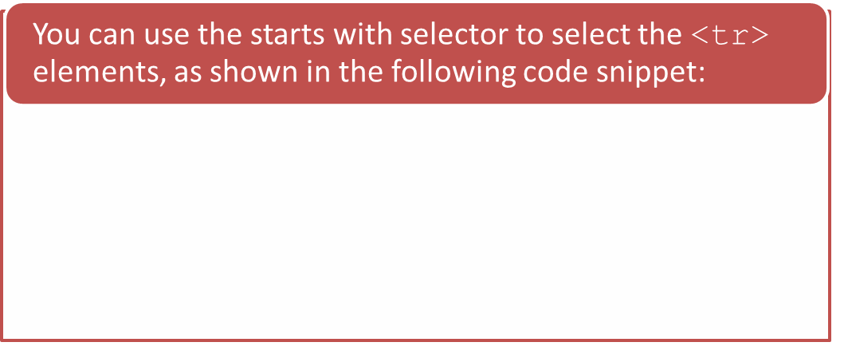
Attribute Selectors (Contd.)
Consider that you have to highlight the details of those courses for which scholarship is available. In the given HTML table, the rows corresponding to the courses, AREA STUDIES, BOTANY, and CELL BIOLOGY, have the value, SCHOLARSHIP, at the beginning of their class names.
<style>
tr[class^="SCHOLARSHIP"]
{
background: yellow;
}
</style>

Slide 22
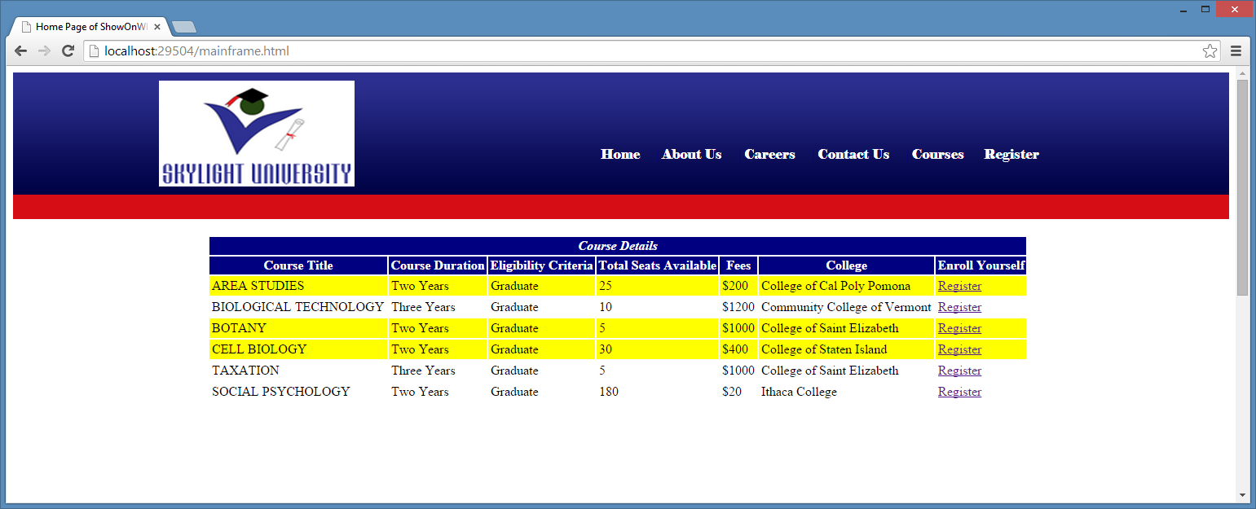
Attribute Selectors (Contd.)
The following figure displays the output of the preceding code snippet.
In the preceding figure, the <tr> elements whose class attribute starts with the value, SCHOLARSHIP, have been highlighted.

Slide 23
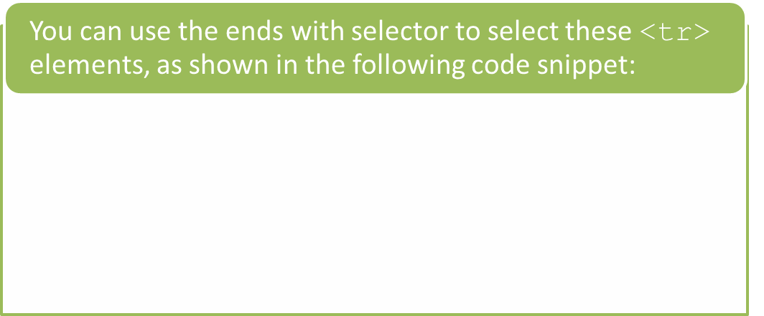
Attribute Selectors (Contd.)
Consider that you have to italicize the details of those courses for which placement is available.
The rows corresponding to the courses, AREA STUDIES, BIOLOGICAL TECHNOLOGY, and TAXATION, have the value, PLACEMENT, at the end of their class names.
<style>
tr[class$="PLACEMENT"]
{
font-style: italic;
}
</style>

Slide 24
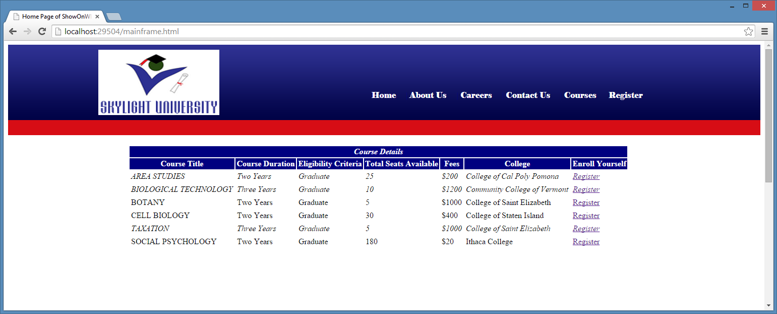
Attribute Selectors (Contd.)
The following figure displays the output of the preceding code snippet.
In the preceding figure, the <tr> elements, whose class attribute ends with the value, PLACEMENT, have been italicized.

Slide 25
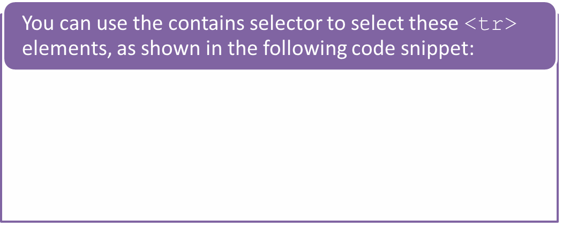
Attribute Selectors (Contd.)
Consider that you have to display the details of those courses for which hostel facility is available in bold.
The rows corresponding to the courses, BOTANY, TAXATION, and SOCIAL PSYCHOLOGY, have the string, HOSTEL, in their class names.
<style>
tr[class*="HOSTEL"]
{
font-weight: bold;
}
</style>

Slide 26
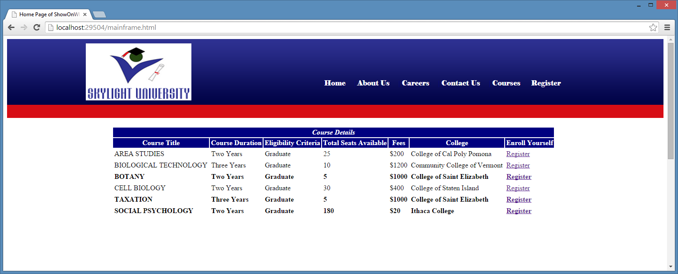
Attribute Selectors (Contd.)
The following figure displays the output of the preceding code snippet.
In the preceding figure, the <tr> elements, whose class attribute contains the string, HOSTEL, have been emboldened.

Slide 27
Just a Minute
The _________ selector is used to select every matching element that is the nth child, of a particular type, of its parent.
  :nth-of-type(n)
  :first-of-type
  :only-of-type
  :nth-last-of-type(n)

Slide 28
Just a Minute (Contd.)
Answer:
  :nth-of-type(n)

Slide 29
Activity: Applying Styles Using CSS Selectors
The management of BuildYourWeb Inc. has viewed the home page of the FoodHub food chain. It did not find the page visually appealing. Therefore, the management asked you to change the design of the website. It asked you to implement the following changes in the home page:
  Change the logo image, add the login and find us links, and display contact details.
  Add hyperlinks for the following menus:
    Home
    Menu
    Recipes
    Best Deal
    About Us
    Contact Us
    The color of the preceding hyperlinks should change to green, when the user hovers the mouse pointer over them.

Slide 30
Activity: Applying Styles Using CSS Selectors (Contd.)
  The following menu should be displayed when the user hovers the mouse pointer over the Recipes hyperlink:
    Apple Pie Muffins
    Avocado BLT Pizza
    Chocolate Pudding
    Italian Pasta
    Indian Curry
    Pimento Cheeseburger
  The following menu should be displayed when the user hovers the mouse pointer over the Menu hyperlink:
    Appetizers
    Soups & Salads
    Kebab-E-Bahar
    Chicken Specialties
    Rice / Biryani
    Kids Corner
    Desserts
    Drinks

Slide 31
Activity: Applying Styles Using CSS Selectors (Contd.)
  The following text should appear in the #860F08 color:
    FoodHub is an American chain of restaurants that enables food lovers to come together and enjoy food. It provides online delivery of food items, 24*7. At FoodHub, you will have some of the city's best destination cafes, bistros, restaurants, fast food, and others under one roof. FoodHub provides its customers a heady combination of surreal surroundings in addition to tongue tickling food of different cuisines. FoodHub is not only the best choice for traditional food at any hour of the day, but also a good place for children to have fun. We provide entertaining facilities, such as puppet shows, for children.
    The text, FoodHub is an American, should also be in bold.
  Create an image gallery for various dishes. Whenever, the user hovers the mouse pointer over the images, a title containing the name of the dish should be displayed.
  Add the images for the available cuisines.
  Add the quick menu as a sidebar.

Slide 32
Activity: Applying Styles Using CSS Selectors (Contd.)
  The following links should be displayed on the quick menu:
    Burgers
    Chicken Specialties
    Desserts
    Drinks
    Kebabs
    Rice / Biryani
    Pastas
    Soup & Salads
  Add a copyright in footer section.

Slide 33
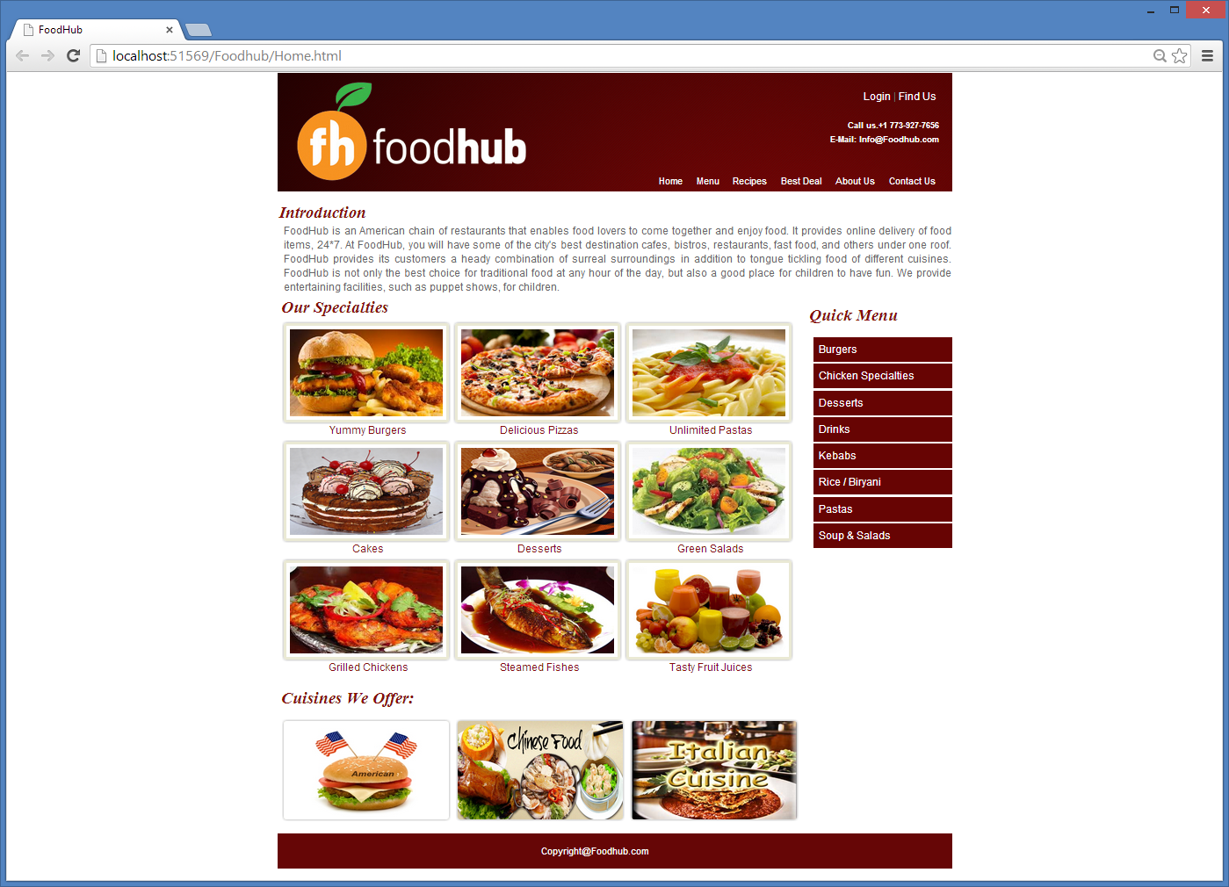
Activity: Applying Styles Using CSS Selectors (Contd.)
Prerequisite: To perform this activity, you need to use the Foodhub.zip file. In addition, you need to use the Images.zip and the JS.zip files.
  The home page should appear as shown in the following figure.

Slide 34
Summary
In this session, you learned that:
  Selectors are used to select and stylize an HTML element or a group of elements.
  Selectors that specify the selection criteria based on the names of the elements are called element selectors.
  Some of the element selectors are:
    element1~element2
    :first-of-type
    :last-of-type
    :nth-child(n)
    :nth-last-child(n)
    :only-of-type
    nth-of-type(n)
  Selectors that specify the selection criteria based on the attributes of elements are called attribute selectors.
  CSS provides a varied range of attribute selectors, such as:
    Starts with
    Ends with
    Contains

Slide 35
What’s Next?
After this session, you need to do the following tasks:
  Read Chapter 2
  Perform Exercise 28 of Chapter 1
  Perform Exercise 1 of Chapter 2

